Slide 1

Make Your ASP.NET Core Apps Amazingly Fast
A Look At Performance Features for Applications

Slide 2

About Your Speaker
Mitchel Sellers
Microsoft MVP, ASPInsider
CEO @ IowaComputerGurus, Inc
Contact Information
msellers@iowacomputergurus.com
@mitchelsellers
Github.com/mitchelsellers
www.mitchelsellers.com

Slide 3

What is a “Fast” Application
What makes an application “fast” to you?
Common Answers
Pages load < 2 seconds
Page size is small
It appears to load quickly
How about these sites?
Amazon.com
Expedia/Kayak/Google Flights

Slide 4

Notes:
10 seconds to full display

Slide 5
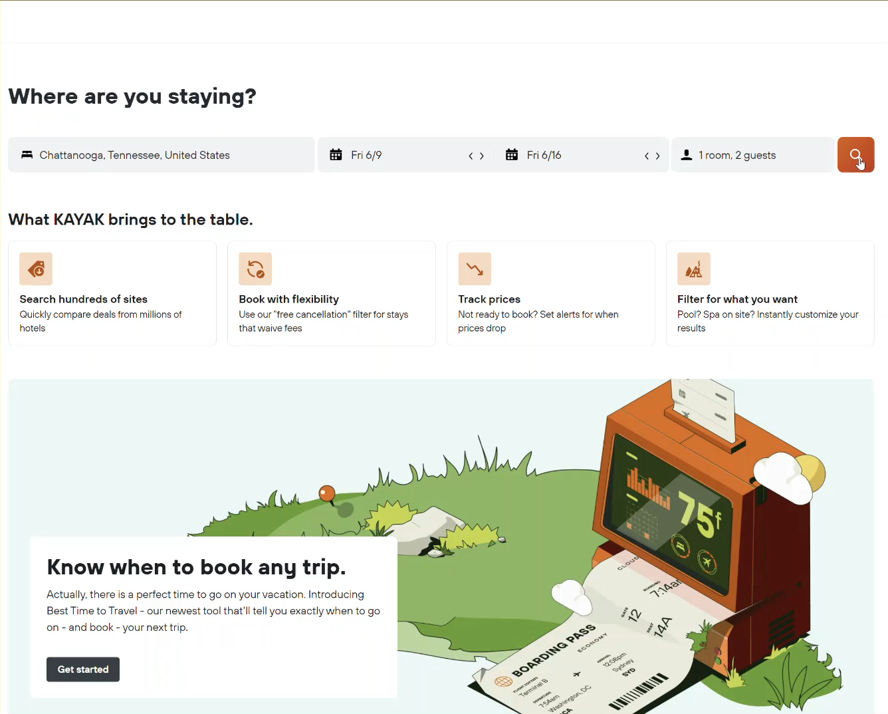
Notes:
6 Seconds - Shimmer

Slide 6

Setting Performance Standards First
Metric Based?
Page Load Time
Tooling Scores
Load Based
X Users per Hour
Y Requests per Second
Perception Based
Needs to “Feel” fast
Commonly, You Will Blend These

Slide 7

Implementing Performance as a Feature
Performance should be architected INTO a solution, not addressed after the fact
Small changes at the beginning can pay back huge dividends
There is no “easy” button!
But there are common culprits

Slide 8

Implementing Data/Output Caching
Two Standards
IMemoryCache
IDistributedCache
API Structures are Different
What is a Distributed Cache
Allows synchronization of cache items across multiple instances
IDistributedCache defaults to a Memory Based Cache
Best to start with IDistributedCache, even if not needed for requirements

Slide 9
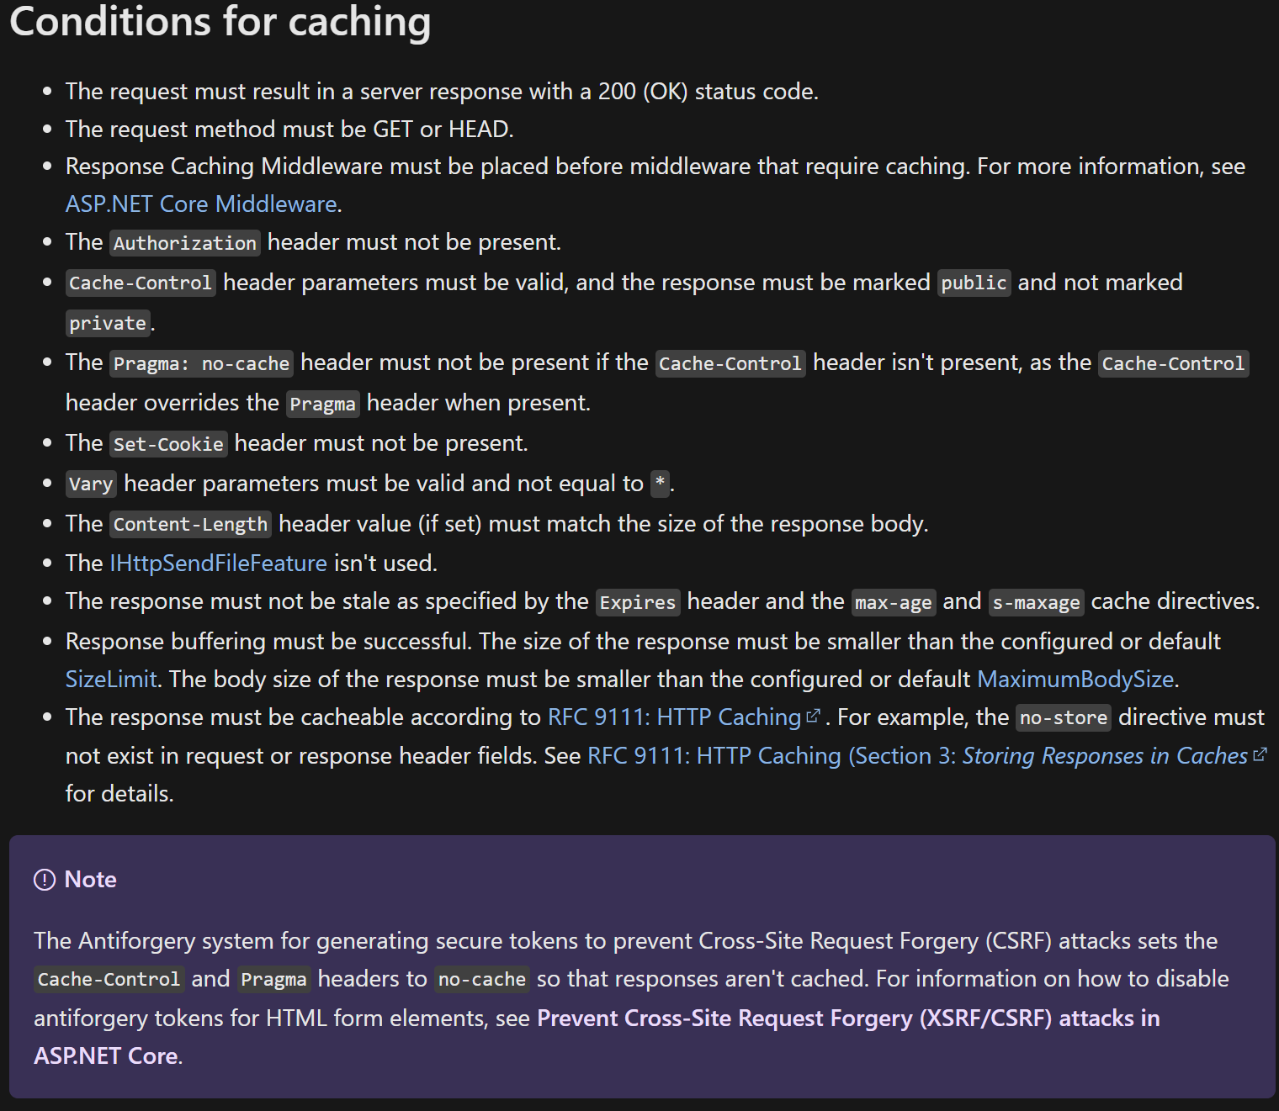

HTTP Response Caching
Enabled by adding two lines to startup
AddResponseCaching()
UseResponseCaching()
Configured on a controller/action/page basis
[ResponseCache(VaryByHeader = "User-Agent", Duration = 30)]
Shouldn’t be used for anything that varies by user or has a login status etc

Slide 10
Caching TagHelpers
Tag helpers for caching rendered snippets of an application, NOT the entire response.
Allow you to cache complex renderings, without having to cache the whole page/content
<distributed-cache name="my-distributed-cache-unique-key-101"> Time Inside Cache Tag Helper: @DateTime.Now </distributed-cache>

Slide 11

EntityFramework Performance Considerations
Example
2023-06-01 23:11:56.940 -05:00 [WRN] Compiling a query which loads related collections for more than one collection navigation, either via 'Include' or through projection, but no 'QuerySplittingBehavior' has been configured. By default, Entity Framework will use 'QuerySplittingBehavior.SingleQuery', which can potentially result in slow query performance. See https://go.microsoft.com/fwlink/?linkid=2134277 for more information. To identify the query that's triggering this warning call 'ConfigureWarnings(w => w.Throw(RelationalEventId.MultipleCollectionIncludeWarning))'.
.AsNoTracking()
Huge performance improvement if change tracking isn’t needed
AddDbContextPool() Rather than AddDbContext()
Monitor for Hidden Log Messages
Warnings for type mismatches
Warnings for queries that split in a less-performant manner
Always Query async!
Watch for N+1 Queries
Page Large Query Results

Slide 12
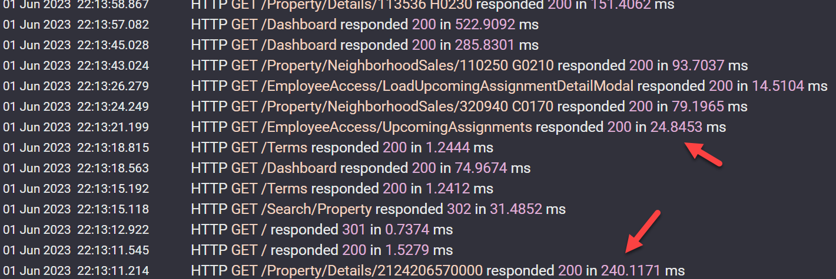
Targeting Slow Areas
ASP.NET Core Internal Logging
EF Core Query Performance
Microsoft.EntityFrameworkCore.Database.Command is the filter key
ASP.NET Request Logging
Start/End request blocks when logging at informational levels
This can be improved using Serilog’s integration for streamlined logging

Slide 13

Bundling/Minification/CDN
Combining JS/CSS and/or Compressing
Reduces payload
Reduces HTTP request counts
Requires third-party solutions
https://learn.microsoft.com/en-us/aspnet/core/client-side/bundling-and-minification?view=aspnetcore-7.0

Slide 14
Resources
Demo Project - https://github.com/mitchelsellers/aspnetdotnetcoreperformance
ASP.NET Core Best Practices – https://learn.microsoft.com/en-us/aspnet/core/fundamentals/best-practices?view=aspnetcore-7.0
ASP.NET Core Performance - https://learn.microsoft.com/en-us/aspnet/core/performance/overview?view=aspnetcore-7.0
Serilog Request Logging - https://github.com/serilog/serilog-aspnetcore#request-logging

